Slide 1
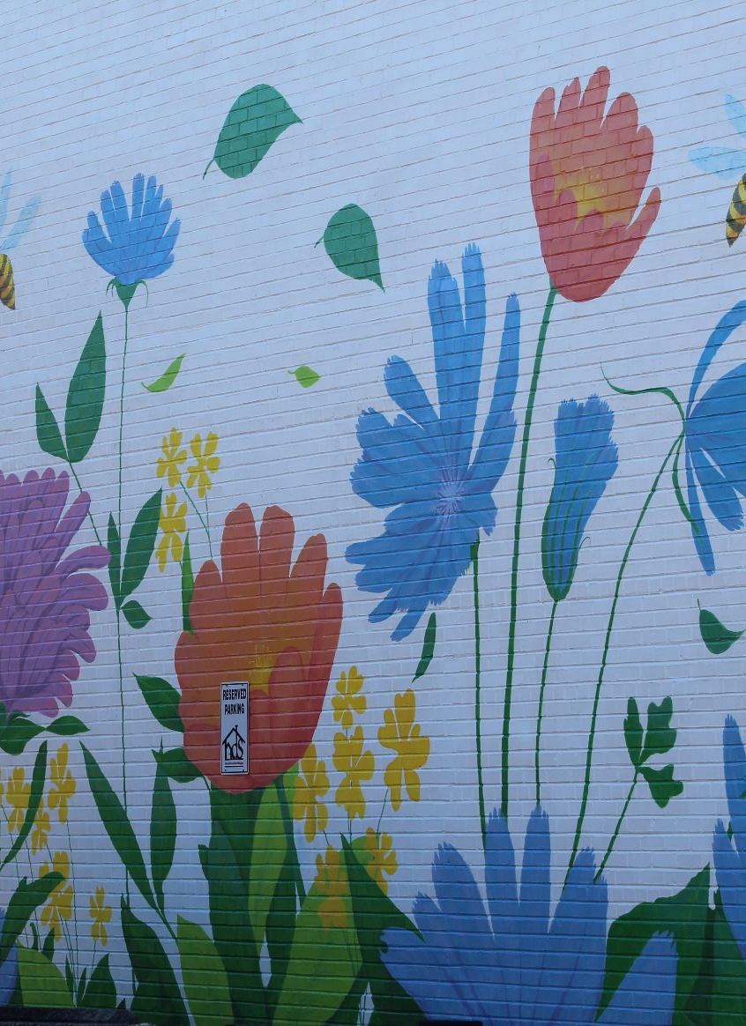
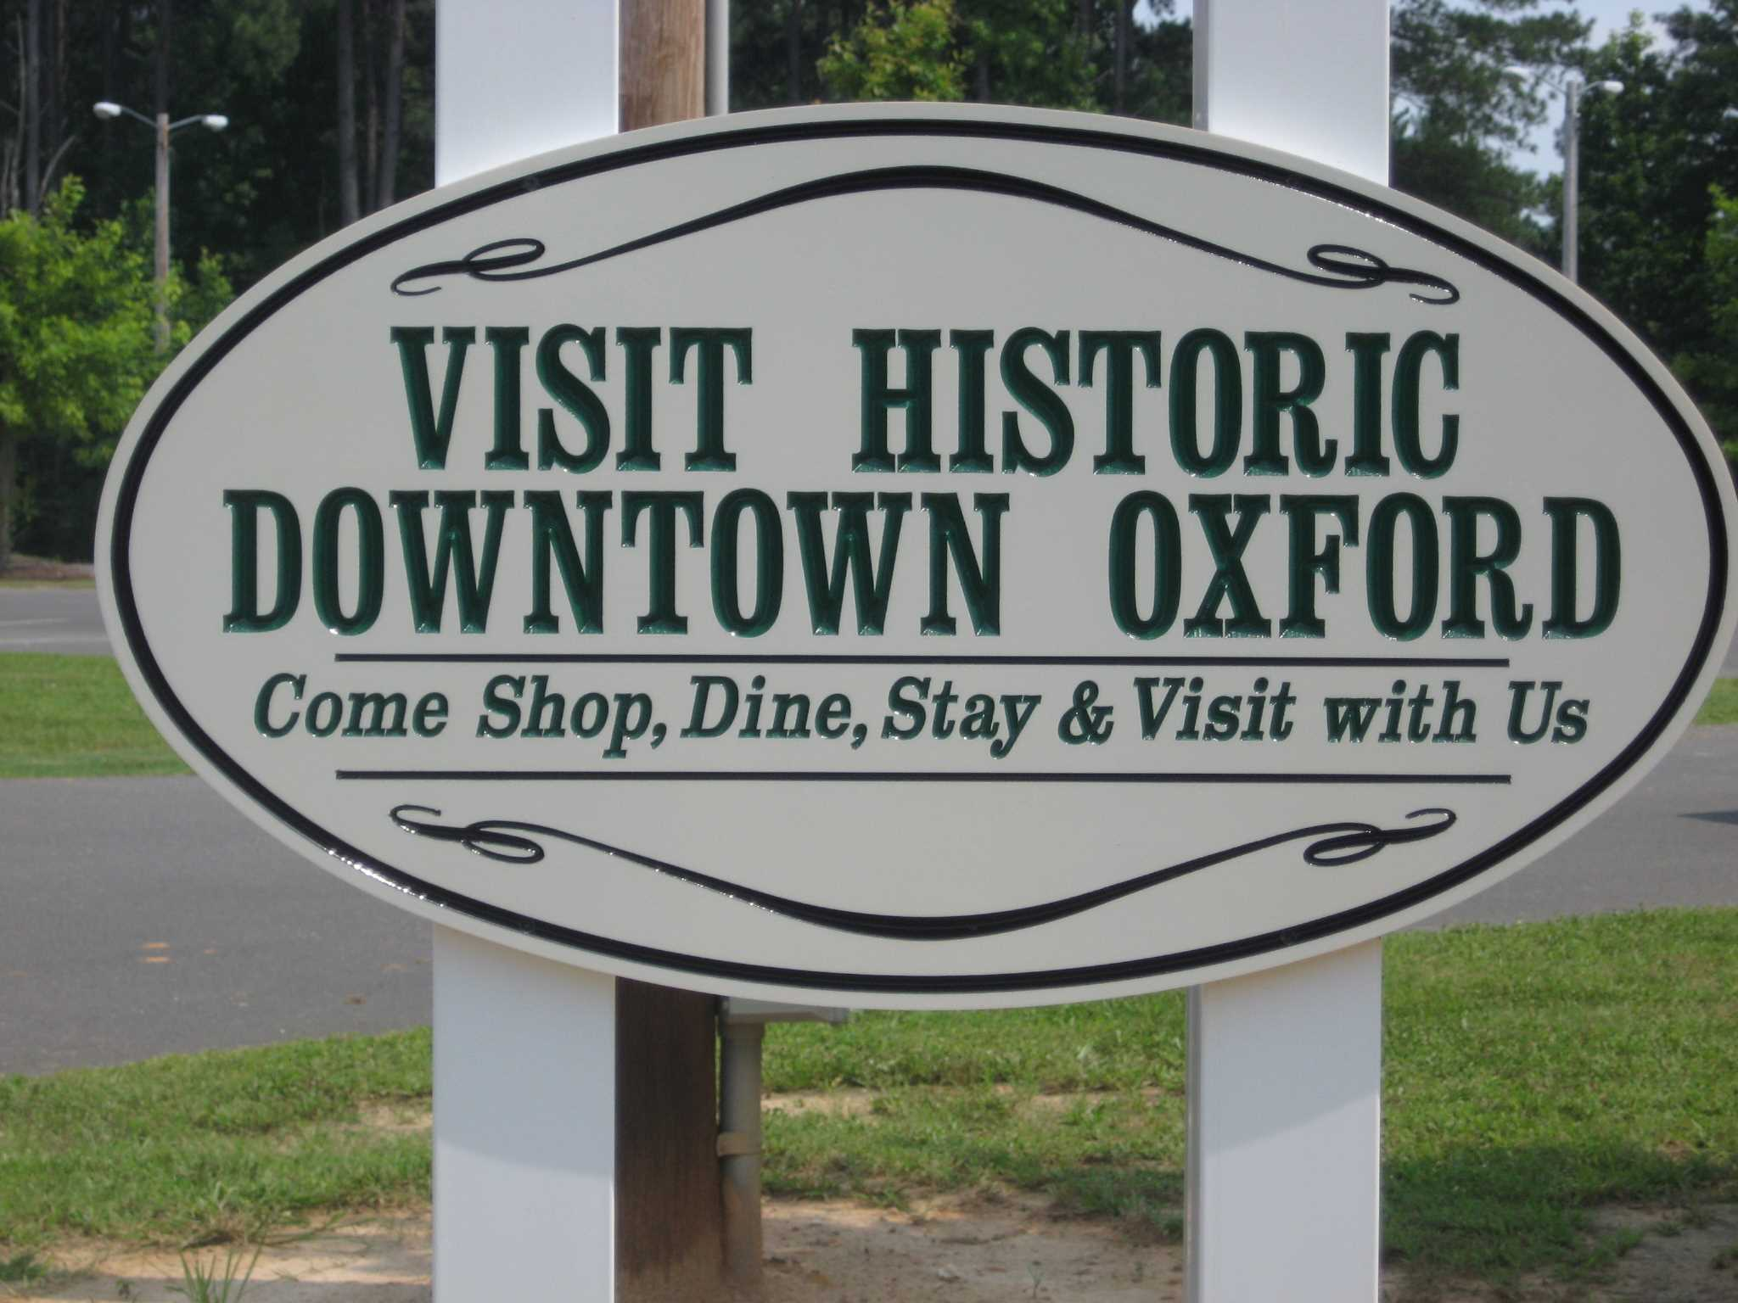
CITY OF OXFORD FY 24-25 BUDGET
subtitle

Slide 2
GENERAL FUND
REVENUE $14,534,300.00
EXPENSES $14,534,300.00

Slide 3
General Fund Revenue $14,453,300.00

Slide 4
Expenditure By Major Function
Personnel –Operations- Capital-Other

Slide 5
Budget Includes Across all Department and Funds
Cost of Living and Merit Wage Increases.
Health Insurance.
Contributions to State Retirement System.
Contribution to 401 K.
Workman’s Compensation.
Pilot program with Enterprise Fleet Management System to monitor vehicle maintenance and vehicle acquisition.

Slide 6
General Fund- $14,453,300.00
Expenditure By Department Summary

Slide 7
General Fund- $14,453,300.00
Expenditure By Percentage
Category | Percentage
Police | 28%
Public Works | 24%
Fire | 14%
Cultural/ Rec. | 10%
Planning/Dev. | 7%
Admin. | 15%
Other | 2%

Slide 8
General Government $539,436.00
BUDGET INCLUDES
Annual Contribution to the Airport Authority.
Website Improvements.
Economic Development and Incentive Program.
Codification Services.
Contribution to Boys and Girls Club.
Council Salaries.
Election Services from the County.
Liability Risk Management Insurance.

Slide 9
Executive Department $813,386.25
BUDGET INCLUDES
Design Services for Public Safety Building.
Aesthetics Enhancements.
Legal Services.
Personnel.
Fleet Management.

Slide 10
Human Resources Department $211,060.68
BUDGET INCLUDES
An administrative assistant position to assist the Planning, Engineering and Human Resources Department.
Increase in the Employee Recognition and Appreciation Programs.
Software Upgrades to allow applications to be taken on-line.

Slide 11
Downtown Development $233,223.00
BUDGET INCLUDES
A full-time position for City Events.
Increase for Hot Sauce Festival to move toward a Regional Festival.
Downtown Enhancements.

Slide 12
Finance Department $791,126.00
BUDGET INCLUDES
Software Services.
Fees to Granville County Tax Collection.
Audit Services.
Grant Writer or Grant Writing Services.
Retired Employees Health Insurance.
Travel and Training

Slide 13
Police Department $3,977,044.00
BUDGET INCLUDES
Motorola In Car Camera System for every car.
License Plate Reader Camera System.
Various Training Courses.
Patrol Rifles.
Riot Gear.
ASP Baton and SCABBARD.
Computer Replacement.
Tactical First Aid Kits.
Tasers.
Bolo Wrap.
Ability to make upgrades or relocate headquarters.
All requested items are funded.

Slide 14
Public Works $3,356,897.57
Buildings and Grounds
Two Mowers.
Truck for Buildings and Grounds.
A trailer.
Enhancements for Cemeteries
Building repairs or relocation for Police Department.
Repairs to Annex which houses Economic Development office.
1 Maintenance Worker Buildings and Grounds Emphasis on Downtown.
1Landscaper.
Security System for City Hall.
Street/ Stormwater
A truck.
2 Maintenance workers Stormwater/Streets.
Equipment Operator Streets.
A trailer.

Slide 15
Fire Department $1,976,710.84
BUDGET INCLUDES
Three additional Fire Fighters $210,000 if we obtain the Safer Grant. If not, successful they won’t be hired.
Six (6) sets of Turnout Gear.
Hydraulic Rescue Extension Ram.
Skid Unit for Existing Trucks.
FLIR Thermal Imager.
Tripod Service Lights.
Volunteer Support.
Testing of equipment and apparatus.
Various Training Courses.
All requested items are funded.

Slide 16
Engineering Department $708,802.00
BUDGET INCLUDES
A project manager/ engineer.
An inspector.
A vehicle.
Computer and office equipment for the new positions.
Increase in funds allocated for Engineering Services related to development.
Doesn’t include:
The request for Engineering Services was $400,000. The allocation is $120,000. If workload exceeds the $120,000 allocation we expect revenues to offset it.

Slide 17
Planning Department $360,802.66
BUDGET INCLUDES
The budget is approximately the same as last year. It continues to fund an additional planner and increase to fund demolition projects.

Slide 18
Recreation Department $1,119,611.00
BUDGET INCLUDES
Improvements to Lake Devin Including a Disc Golf Course.
Maintenance Equipment.
Increases in Part-Time Staff.
Building and Field Maintenance.
Doesn’t include
A Recreation Supervisor new position.
Property acquisition.

Slide 19
Theater $219,200.00
Revenues to equal Expenses
BUDGET INCLUDES
Operations
Entertainment
Capital upstart cost such as improved sound and light equipment are allocations through American Rescue Plan funds in the current budget.

Slide 20
Capital Improvement Plan
Police Department
Notable Purchases from Prior Plan
5 Patrol Vehicles
35 Body Cameras
Fire Department
Notable Purchases from Prior Plan
Aerial Truck Refurbishment

Slide 21
Capital Improvement Plan
Parks and Recreation Department
Notable Purchases from Prior Plan
Lake Devin Spillway Bridge
Hix Gym Parking lot
Lake Devin Walkway
Public Works Department
Notable Purchases from Prior Plan
Window Replacement City Hall
Dump Truck

Slide 22
FIVE YEAR PROJECTION
Expense Assumptions
Personnel Increase cost of 4% annually.
Operating Expense increase cost 1% annually.
Reduction in capital equipment expenses.
Leasing or Lease purchasing vehicles and larger equipment items.
Staff enhancements especially in Public Safety.
Financing the following
FY 27 Public Safety Station.
FY 28 Park and Recreation Projects.
Anticipating relocating Public Works between FY2026 - FY 2028.
FY 30 Increase spending towards Road Maintenance.
Revenue Assumptions
No increases in the tax rate.
No increase in other rates, but conservative increases 1%-2% in other revenue sources due to increase population.
New homes valued at $225,000 each.
Minimal Commercial or Industrial Development.
Fiscal Year New Units
FY 26 310
FY 27 635
FY 28 772
FY 29 512
FY 30 422

Slide 23
The General Fund addresses the following:
Improves the ability to be more responsive to developers and manage construction projects.
Short- term and long-term concerns with Public Safety facilities.
Better equips Public Safety departments to perform their duties and improve service to the public.
Increases capacity to search for other funding sources.
Expands the cultural and recreation opportunities.
Increases the ability of Public Works to address issues related to stormwater, beautification, cemeteries, debris collection and street repairs.
Continues to enhance the efforts to recruit, retain and recognize employees.
Invests in improving the aesthetics of downtown and gateways.
Improves the ability of the City to provide economic incentives for investment.

